Slide 1
Lecture 10 Convolutional and Deep Neural Networks
EE-uy 4563/EL-GY 9123: Introduction to machine learning
Prof. Sundeep rangan with modification by Yao Wang

Slide 2
Outline
Motivation: ImageNet Large-Scale Visual Recognition Challenge (ILSVR)
Deep Networks and Feature Hierarchies
2D convolutions
Convolutional neural networks
Creating and visualizing convolutional layers in Keras
Backpropagation training in CNNs
Exploring VGG16: A state-of-the-art deep network

Slide 3
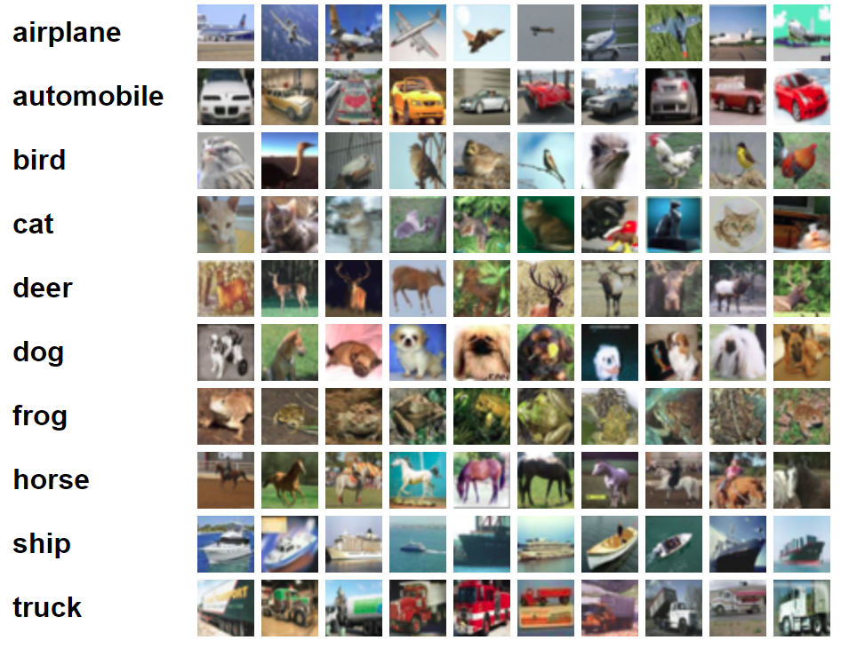
Large-Scale Image Classification
Pre-2009, many image recognition systems worked on relatively small datasets
MNIST: 10 digits
CIFAR 10 (right)
CIFAR 100
…
Small number of classes (10-100)
Low resolution (eg. 32 x 32 x 3)
Performance saturated
Difficult to make significant advancements
https://www.cs.toronto.edu/~kriz/cifar.html

Slide 4
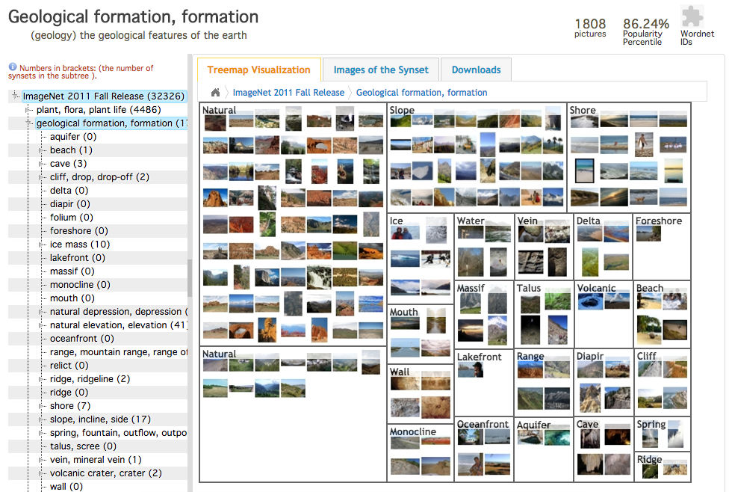
ImageNet (2009)
Better algorithms need better data
Build a large-scale image dataset
2009 CVPR paper:
3.2 million images
Annotated by mechanical turk
Much larger scale than any previous
Hierarchical categories
Deng, J., Dong, W., Socher, R., Li, L. J., Li, K., & Fei-Fei, L. (2009, June). Imagenet: A large-scale hierarchical image database. In Computer Vision and Pattern Recognition, 2009. CVPR 2009. IEEE Conference on (pp. 248-255). IEEE.

Slide 5
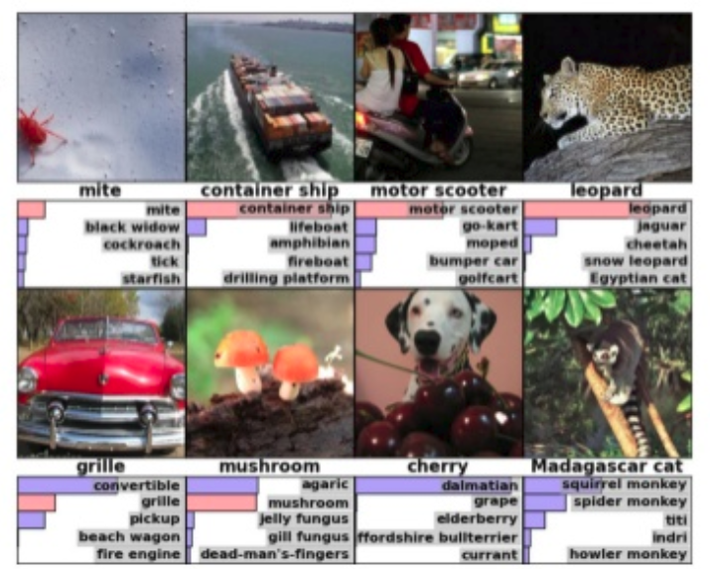
ILSVRC
ImageNet Large-Scale Visual Recognition Challenge
First year of competition in 2010
Many developers tried their algorithms
Many challenges:
Objects in variety of positions, lighting
Occlusions
Fine-grained categories (e.g. African elephants vs. Indian elephants)
…

Slide 6
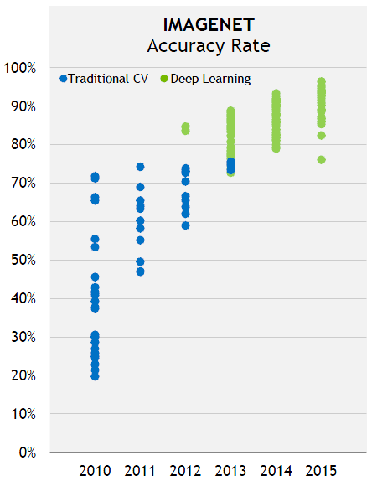
Deep Networks Enter 2012
2012: Stunning breakthrough by the first deep network
“AlexNet” from U Toronto
Easily won ILSVRC competition
Top-5 error rate: 15.3%, second place: 25.6%
Soon, all competitive methods are deep networks

Slide 7
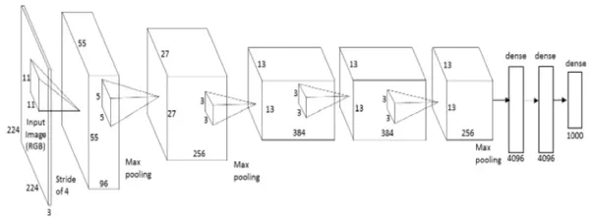
Alex Net
Alex Krizhevsky, Ilya Sutskever, Geoffrey E. Hinton, University of Toronto, 2012
Key idea: Build a very deep neural network
60 million parameters, 650000 neurons
5 conv layers + 3 FC layers
Final is 1000-way softmax

Slide 8
Outline
Motivation: ImageNet Large-Scale Visual Recognition Challenge (ILSVR)
Deep Networks and Feature Hierarchies
2D convolutions
Convolutional neural networks
Backpropagation training in CNNs
Exploring VGG16: A state-of-the-art deep network

Slide 9
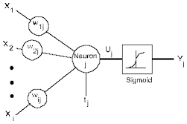
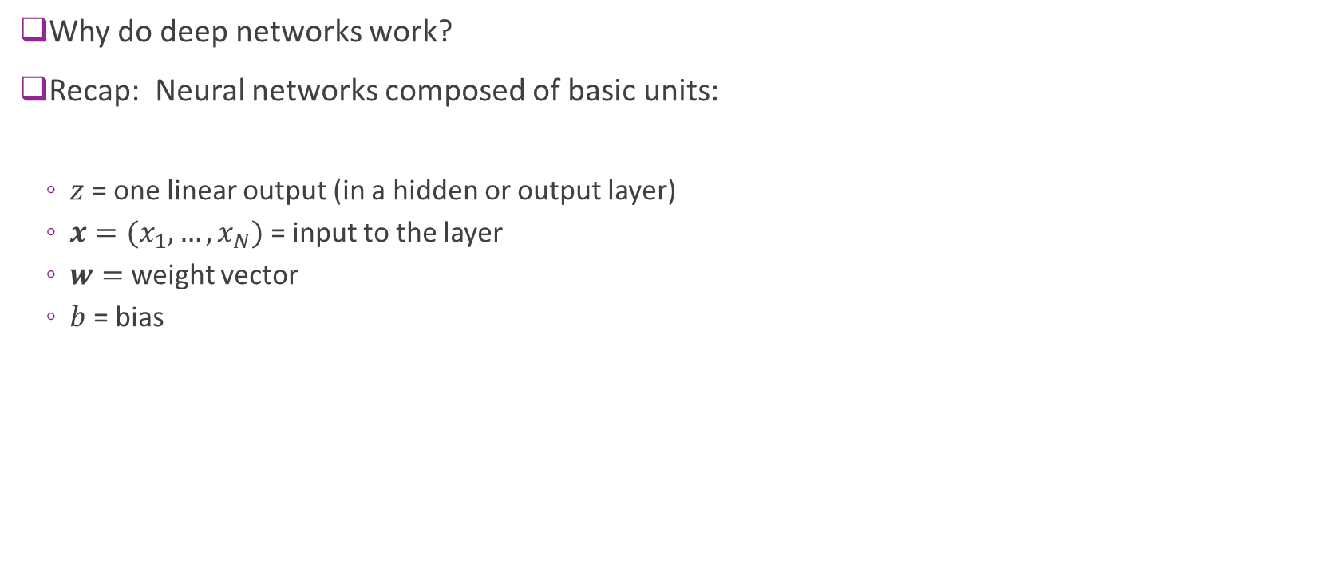
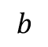
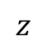
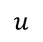
Neural Network Units
Why do deep networks work?
Recap: Neural networks composed of basic units:
$z$ = one linear output (in a hidden or output layer)
$x=(x_{1},…,x_{N})$ = input to the layer
$w=$ weight vector
$b$ = bias
$$z$$
$$u$$
$$b$$

Slide 10
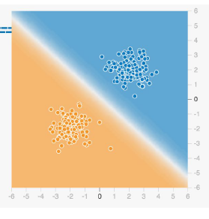
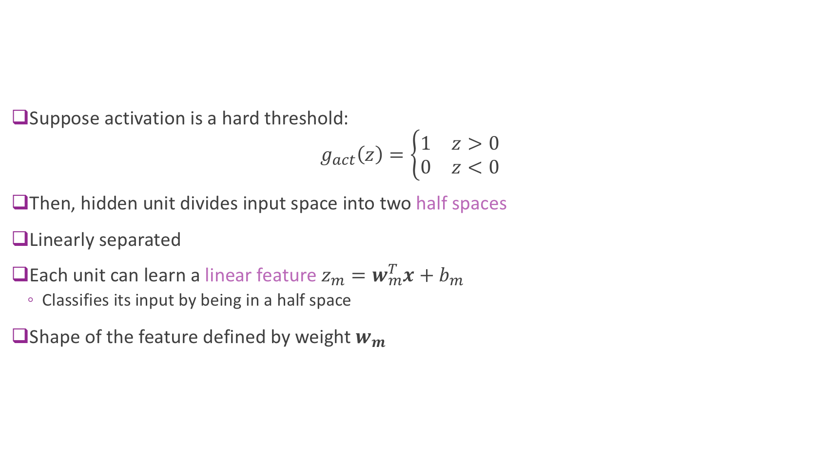
Linear Feature
Suppose activation is a hard threshold: $g_{act}\left(z\right)=\left\{\begin{matrix}1 & z>0 \\ 0 & z<0\end{matrix}\right.$
Then, hidden unit divides input space into two half spaces
Linearly separated
Each unit can learn a linear feature $z_{m}=w_{m}^{T}x+b_{m}$
Classifies its input by being in a half space
Shape of the feature defined by weight $w_{m}$

Slide 11
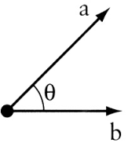
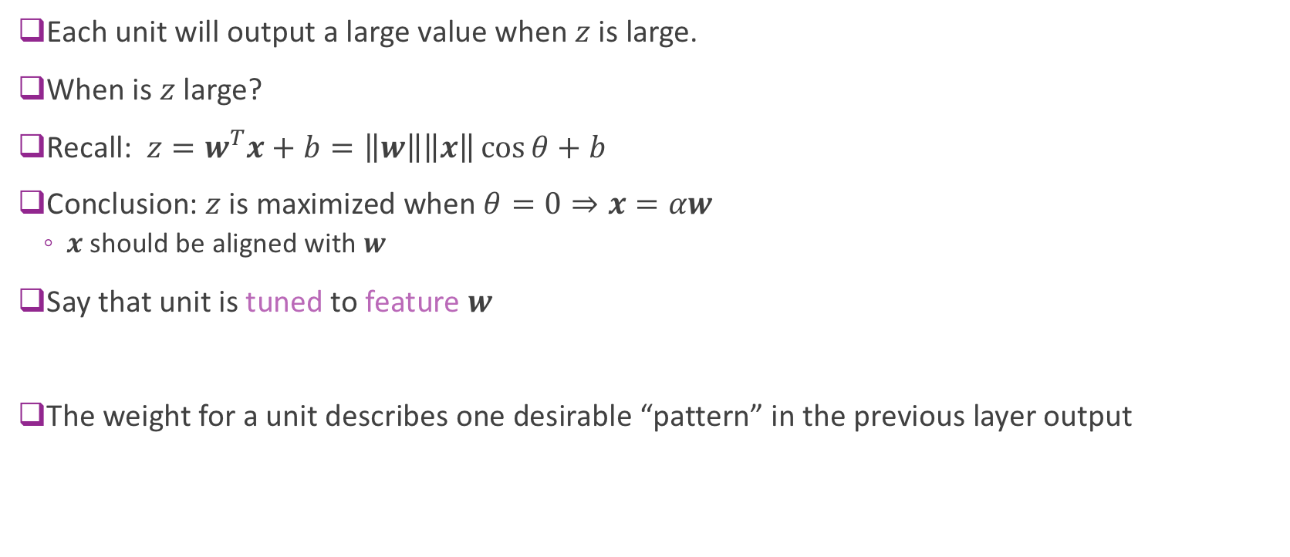

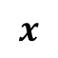
Tuning to a Feature
Each unit will output a large value when $z$ is large.
When is $z$ large?
Recall: $z=w^{T}x+b=\left\|w\right\|\left\|x\right\|\cos{θ}+b$
Conclusion: $z$ is maximized when $θ=0⇒x=αw$
$x$ should be aligned with $w$
Say that unit is tuned to feature $w$
The weight for a unit describes one desirable “pattern” in the previous layer output
$$x$$
$$w$$

Slide 12
Classifying a Nonlinear Region
Nonlinear regions
Build from linear regions
Picture to left:
Output of Tensorboard
Tool in TensorFlow
Provided for visualizing neural nets
From Kaz Sato, “Google Cloud Platform Empowers
TensorFlow and Machine Learning”

Slide 13
What about a More Complicated Region?

Slide 14
Use Multiple Layers
More hidden layers
Hierarchies of features
Generate very complex shapes

Slide 15
Can you Classify This?

Slide 16
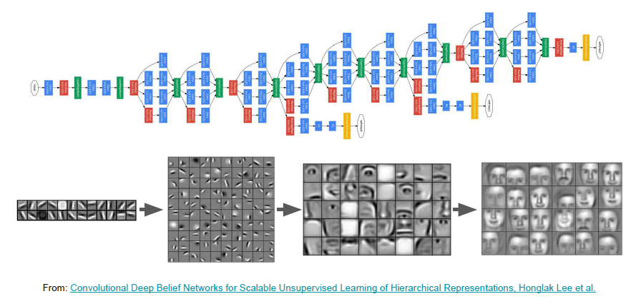
Build a Deep Neural Network

Slide 17
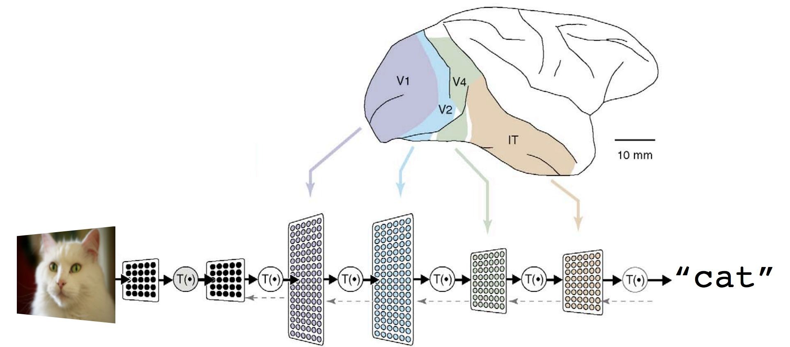
Biological Inspiration
Processing in the brain uses multi-layer processing

Slide 18
History and Why Now?
Early works:
Using multiple layers dates to 1965 (Ivakhenko and Lapa)
Convolutional networks with pooling (Fukushima, 1979)
Back-propagation with a CNN on MNIST (LeCun, 1993)
But, larger networks were a challenge:
Vanishing gradient
Lack of data, over-fitting
Computational power
AlexNet:
ReLU and dropout

Slide 19
Outline
Motivation: ImageNet Large-Scale Visual Recognition Challenge (ILSVR)
Deep Networks and Feature Hierarchies
2D convolutions
Convolutional neural networks
Backpropagation training in CNNs
Exploring VGG16: A state-of-the-art deep network

Slide 20
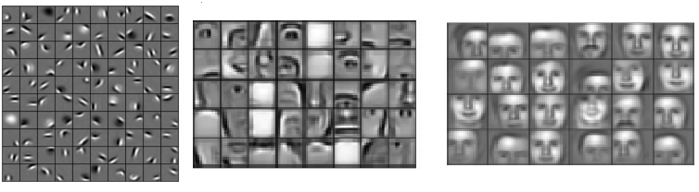
Local Features
Early layers in deep neural networks often find local features
Small patterns in larger image
Examples: Small lines, curves, edges
Build more complex classification from the local features

Slide 21
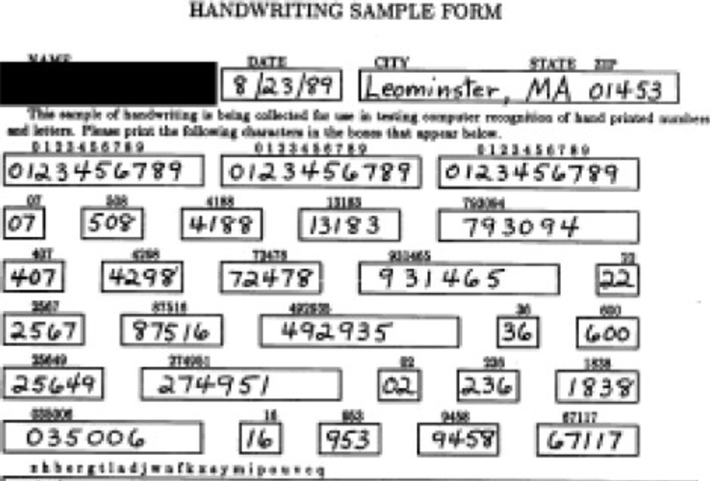
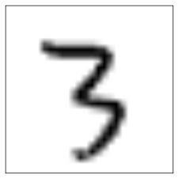
Local Features
How do we find local features?
A localization problem.
Example: Find the digit “3” in the form

Slide 22
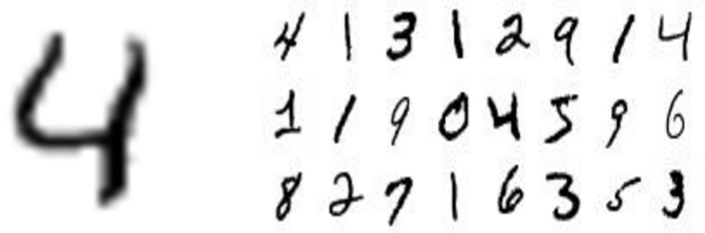
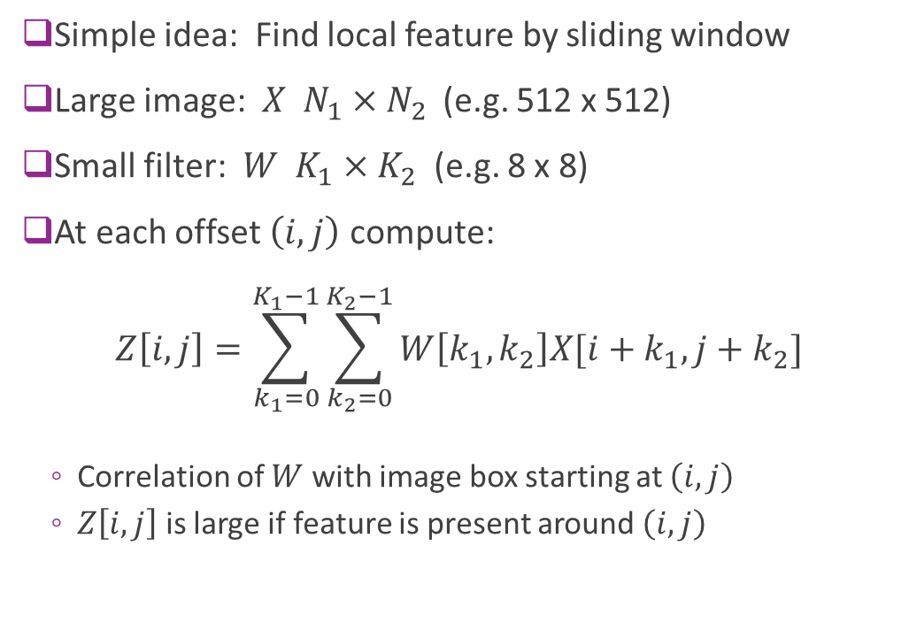
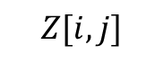


Localization via a Sliding Window
Simple idea: Find local feature by sliding window
Large image: $X N_{1}×N_{2}$ (e.g. 512 x 512)
Small filter: $W K_{1}×K_{2}$ (e.g. 8 x 8)
At each offset $\left(i,j\right)$ compute: $Z\left[i,j\right]=\sum_{k_{1}=0}^{K_{1}−1}{\sum_{k_{2}=0}^{K_{2}−1}{W\left[k_{1},k_{2}\right]X[i+k_{1},j+k_{2}]}}$
Correlation of $W$ with image box starting at $\left(i,j\right)$
$Z\left[i,j\right]$ is large if feature is present around $\left(i,j\right)$
Filter $W$
Image $X$
$$Z[i,j]$$
High
Low

Slide 23
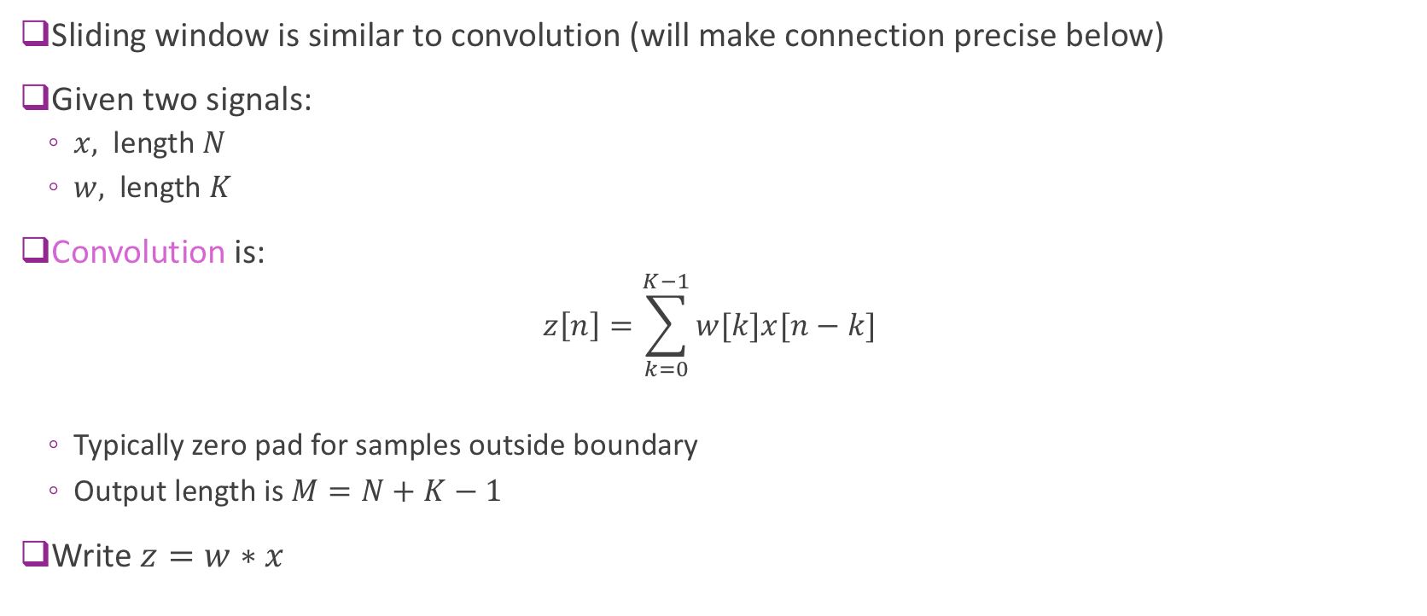
Convolution in 1D
Sliding window is similar to convolution (will make connection precise below)
Given two signals:
$x,$ length $N$
$w,$ length $K$
Convolution is:
$$z\left[n\right]=\sum_{k=0}^{K−1}{w[k]x[n−k]}$$
Typically zero pad for samples outside boundary
Output length is $M=N+K−1$
Write $z=w∗x$

Slide 24
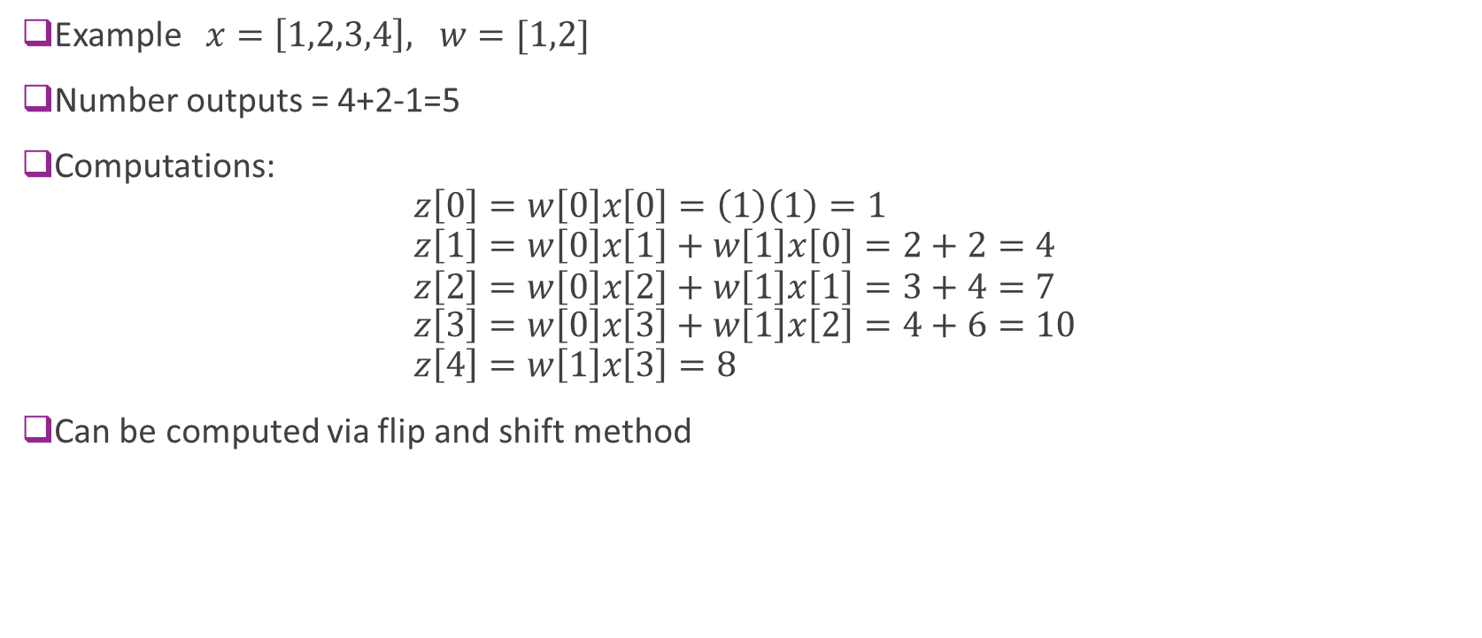
1D Convolution Example
Example $x=\left[1,2,3,4\right], w=[1,2]$
Number outputs = 4+2-1=5
Computations: $z\left[0\right]=w\left[0\right]x\left[0\right]=\left(1\right)\left(1\right)=1$ $z\left[1\right]=w\left[0\right]x\left[1\right]+w\left[1\right]x\left[0\right]=2+2=4$ $z\left[2\right]=w\left[0\right]x\left[2\right]+w\left[1\right]x\left[1\right]=3+4=7$ $z\left[3\right]=w\left[0\right]x\left[3\right]+w\left[1\right]x\left[2\right]=4+6=10$ $z\left[4\right]=w\left[1\right]x\left[3\right]=8$
Can be computed via flip and shift method

Slide 25
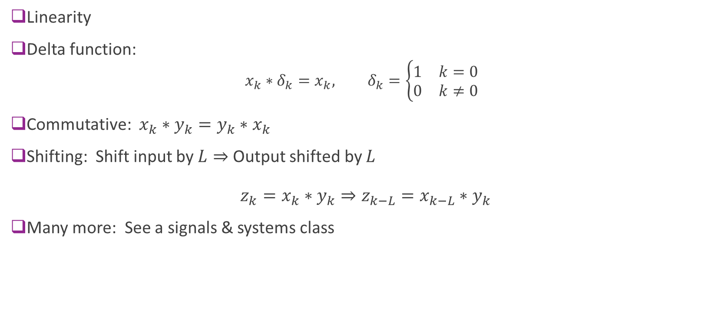
Properties of Convolution
Linearity
Delta function:
$$x_{k}∗δ_{k}=x_{k}, δ_{k}=\left\{\begin{matrix}1 & k=0 \\ 0 & k≠0\end{matrix}\right.$$
Commutative: $x_{k}∗y_{k}=y_{k}∗x_{k}$
Shifting: Shift input by $L⇒$ Output shifted by $L$ $z_{k}=x_{k}∗y_{k}⇒z_{k−L}=x_{k−L}∗y_{k}$
Many more: See a signals & systems class

Slide 26
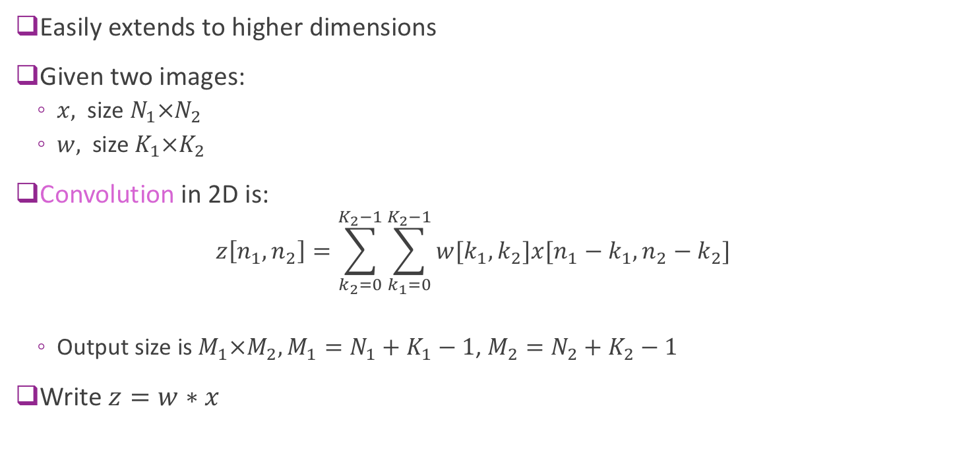
Convolution in 2D
Easily extends to higher dimensions
Given two images:
$x,$ size $N_{1}×N_{2}$
$w,$ size $K_{1}×K_{2}$
Convolution in 2D is:
$$z\left[n_{1},n_{2}\right]=\sum_{k_{2}=0}^{K_{2}−1}{\sum_{k_{1}=0}^{K_{2}−1}{w[k_{1},k_{2}]x[n_{1}−k_{1},n_{2}−k_{2}]}}$$
Output size is $M_{1}×M_{2},M_{1}=N_{1}+K_{1}−1$, $M_{2}=N_{2}+K_{2}−1$
Write $z=w∗x$

Slide 27
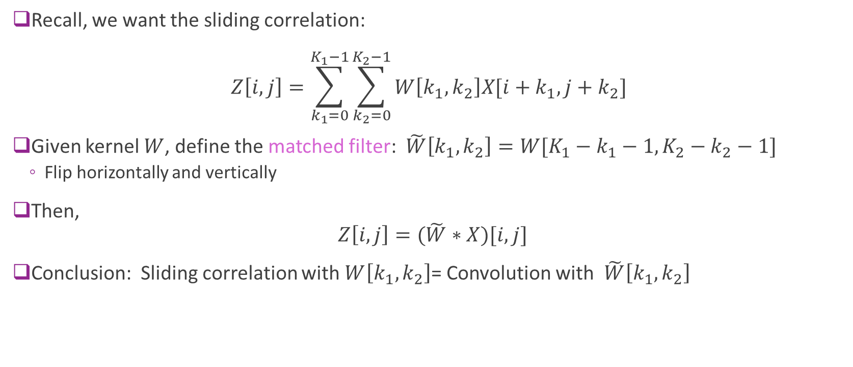
Convolution and Matched Filter
Recall, we want the sliding correlation: $Z\left[i,j\right]=\sum_{k_{1}=0}^{K_{1}−1}{\sum_{k_{2}=0}^{K_{2}−1}{W\left[k_{1},k_{2}\right]X[i+k_{1},j+k_{2}]}}$
Given kernel $W$, define the matched filter: $\tilde{W}\left[k_{1},k_{2}\right]=W[K_{1}−k_{1}−1,K_{2}−k_{2}−1]$
Flip horizontally and vertically
Then, $Z\left[i,j\right]=(\tilde{W}∗X)[i,j]$
Conclusion: Sliding correlation with $W\left[k_{1},k_{2}\right]$= Convolution with $\tilde{W}\left[k_{1},k_{2}\right]$

Slide 28
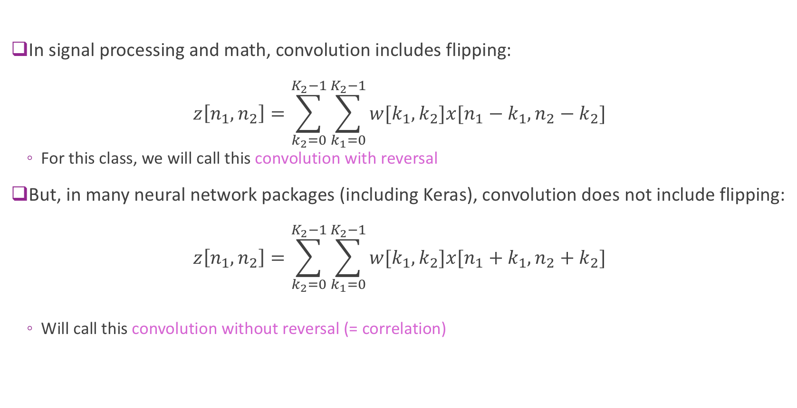
Terminology
In signal processing and math, convolution includes flipping: $z\left[n_{1},n_{2}\right]=\sum_{k_{2}=0}^{K_{2}−1}{\sum_{k_{1}=0}^{K_{2}−1}{w[k_{1},k_{2}]x[n_{1}−k_{1},n_{2}−k_{2}]}}$
For this class, we will call this convolution with reversal
But, in many neural network packages (including Keras), convolution does not include flipping: $z\left[n_{1},n_{2}\right]=\sum_{k_{2}=0}^{K_{2}−1}{\sum_{k_{1}=0}^{K_{2}−1}{w[k_{1},k_{2}]x[n_{1}+k_{1},n_{2}+k_{2}]}}$
Will call this convolution without reversal (= correlation)

Slide 29
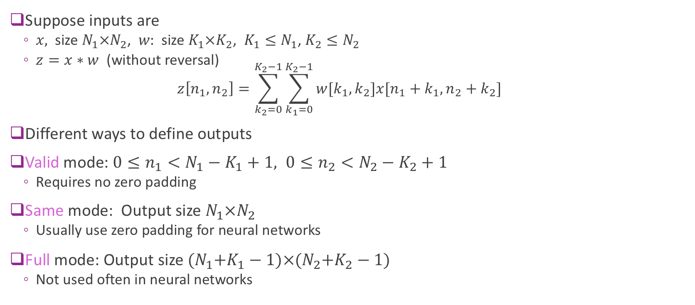
Boundary Conditions
Suppose inputs are
$x,$ size $N_{1}×N_{2}$, $w:$ size $K_{1}×K_{2}$, $K_{1}≤N_{1}$, $K_{2}≤N_{2}$
$z=x∗w$ (without reversal) $z\left[n_{1},n_{2}\right]=\sum_{k_{2}=0}^{K_{2}−1}{\sum_{k_{1}=0}^{K_{2}−1}{w[k_{1},k_{2}]x[n_{1}+k_{1},n_{2}+k_{2}]}}$
Different ways to define outputs
Valid mode: $0≤n_{1}<N_{1}−K_{1}+1, 0≤n_{2}<N_{2}−K_{2}+1$
Requires no zero padding
Same mode: Output size $N_{1}×N_{2}$
Usually use zero padding for neural networks
Full mode: Output size ${(N}_{1}+K_{1}−1)×{(N}_{2}+K_{2}−1)$
Not used often in neural networks

Slide 30
Valid region
Input image
Output depends on both inside and outside boundary pixels
N-K+1
K
Filter mask
N
N
N+K-1
“valid”
“same”
“full”
Note that with convolution with reversal, the boundary effect will be observed at the top and left sides (see demo_conv)

Slide 31

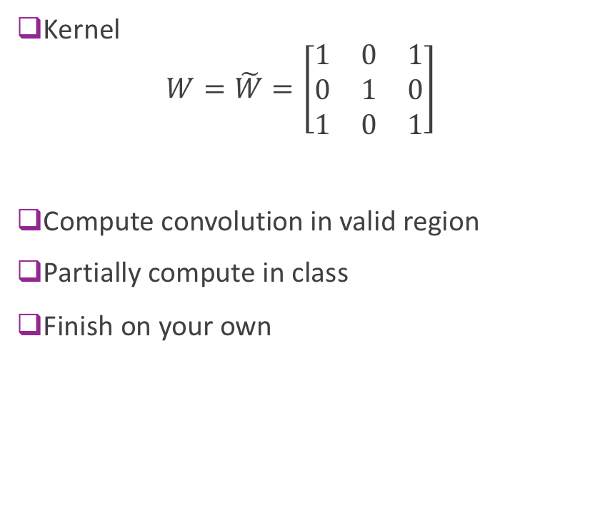
Convolution 2D Example
Kernel $W=\tilde{W}=\left[\begin{matrix}1 & 0 & 1 \\ 0 & 1 & 0 \\ 1 & 0 & 1\end{matrix}\right]$
Compute convolution in valid region
Partially compute in class
Finish on your own
https://stats.stackexchange.com/questions/199702/1d-convolution-in-neural-networks

Slide 32
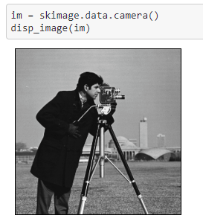
Example Convolution in Python
Load an image
Use skimage package
Many routines for image processing
Also need scipy signal package
import scipy.signal
import skimage.data
Convolution:
scipy.signal.convolve2d(im, G, mode='valid')

Slide 33
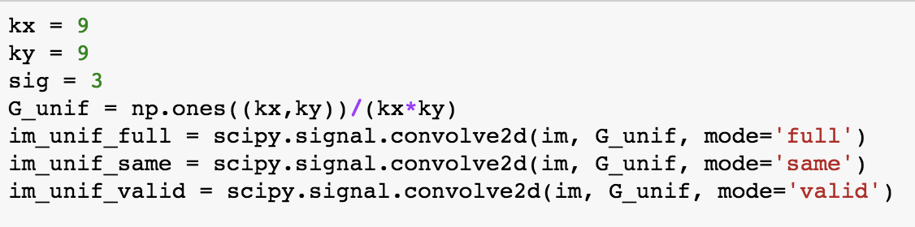
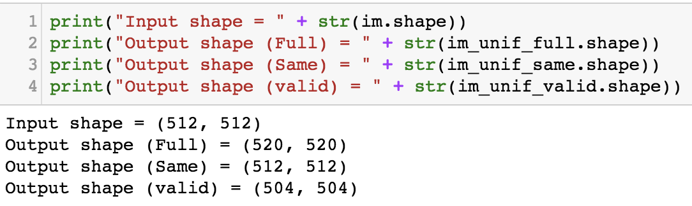
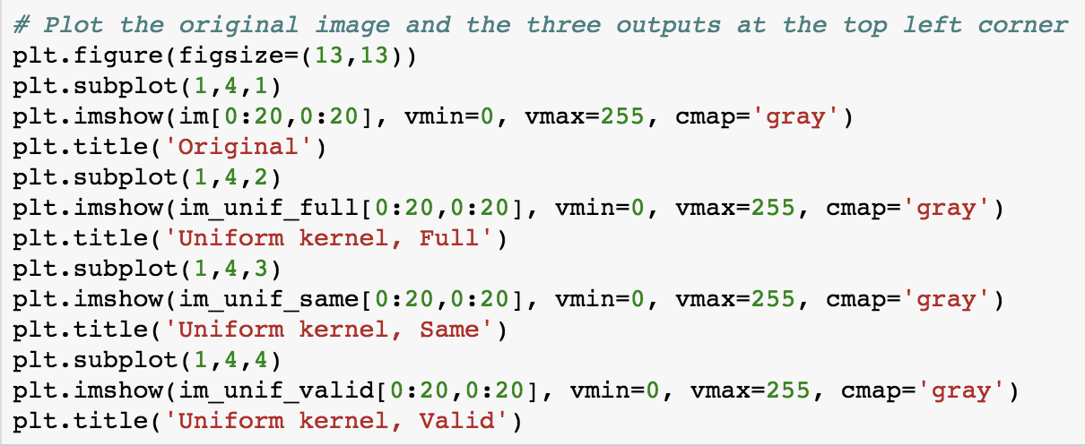
Using convolution for averaging with different boundary options

Slide 34
Averaging with different window sizes

Slide 35
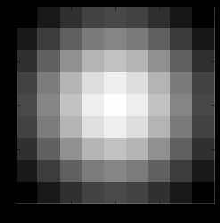
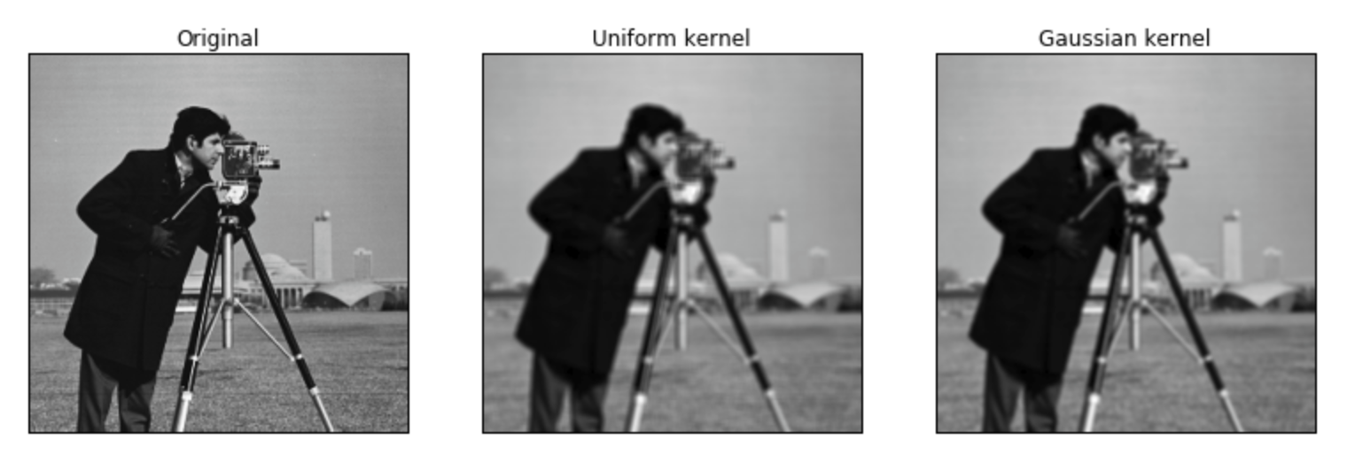
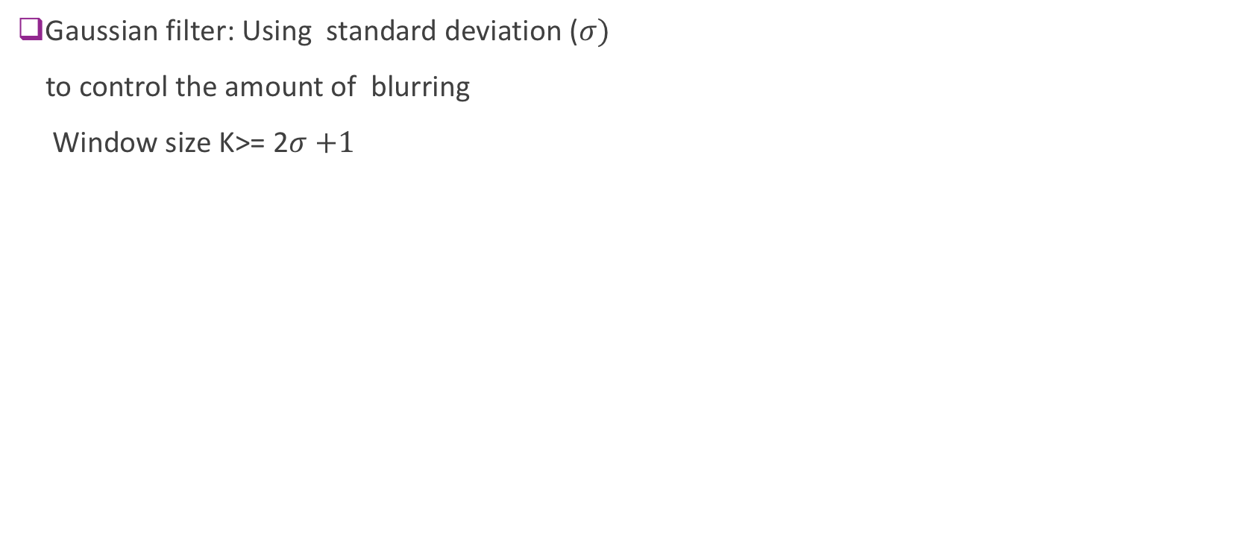
Averaging vs. Gaussian Filtering for Noise Removal
Gaussian filter: Using standard deviation ($σ)$
to control the amount of blurring
Window size K>= 2$σ$ $+1$
9x9 Gaussian blur kernel

Slide 36
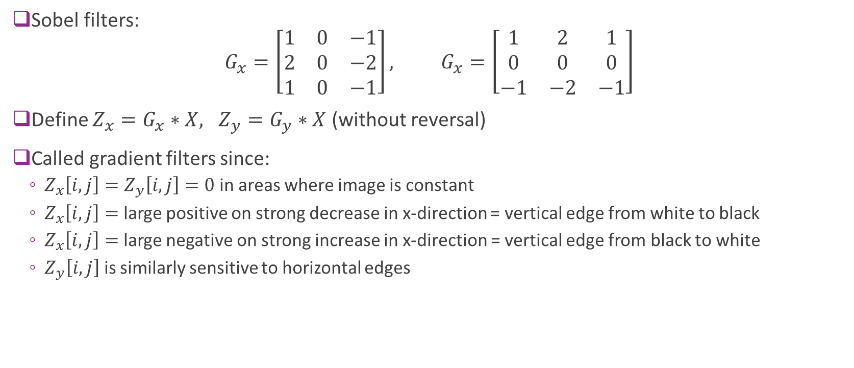
Gradient filter (edge detection)
Sobel filters: $G_{x}=\left[\begin{matrix}1 & 0 & −1 \\ 2 & 0 & −2 \\ 1 & 0 & −1\end{matrix}\right], G_{x}=\left[\begin{matrix}1 & 2 & 1 \\ 0 & 0 & 0 \\ −1 & −2 & −1\end{matrix}\right]$
Define $Z_{x}=G_{x}∗X, Z_{y}=G_{y}∗X$ (without reversal)
Called gradient filters since:
$Z_{x}\left[i,j\right]=Z_{y}\left[i,j\right]=0$ in areas where image is constant
$Z_{x}\left[i,j\right]=$ large positive on strong decrease in x-direction = vertical edge from white to black
$Z_{x}\left[i,j\right]=$ large negative on strong increase in x-direction = vertical edge from black to white
$Z_{y}\left[i,j\right]$ is similarly sensitive to horizontal edges

Slide 37
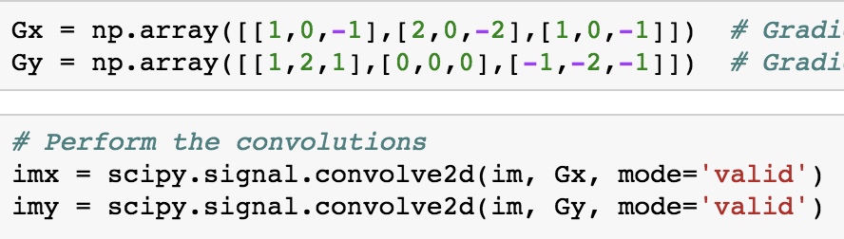
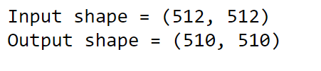
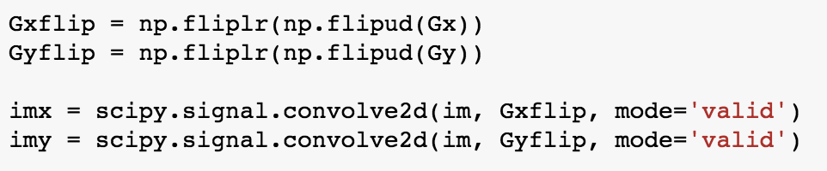
Computing gradients using Sobel filter
Conv. with reverval (using original filter)
Conv. without reversal (first flipping the filter)

Slide 38
Outline
Motivation: ImageNet Large-Scale Visual Recognition Challenge (ILSVR)
Deep Networks and Feature Hierarchies
2D convolutions
Convolutional neural networks
Creating and visualizing convolutional layers in Keras
Backpropagation training in CNNs
Exploring VGG16: A state-of-the-art deep network

Slide 39
Classic CNN Structure
Alex Net example
Each convolutional layer has:
2D convolution
Activation (eg. ReLU)
Pooling or sub-sampling
Convolutional layers
2D convolution with Activation and pooling / sub-sampling
Fully connected layers
Matrix multiplication & activation

Slide 40
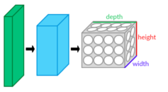
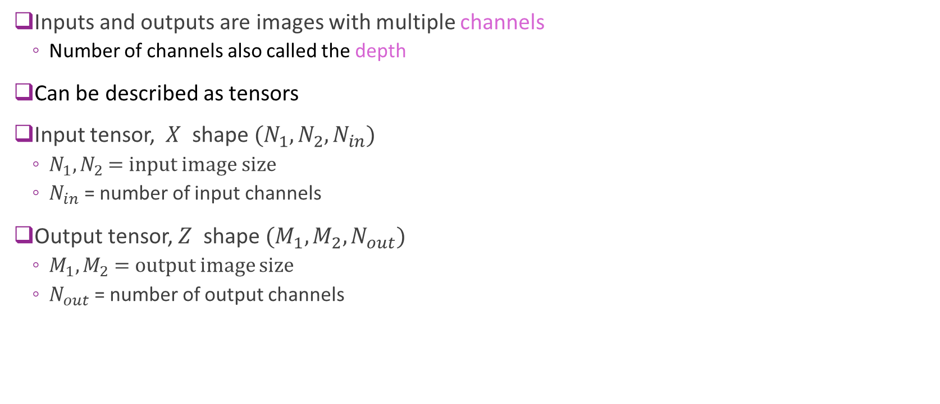
Convolutional Inputs & Outputs
Inputs and outputs are images with multiple channels
Number of channels also called the depth
Can be described as tensors
Input tensor, $X$ shape $(N_{1},N_{2},N_{in})$
$N_{1},N_{2}$ = input image size
$N_{in}$ = number of input channels
Output tensor, $Z$ shape $(M_{1},M_{2},N_{out})$
$M_{1},M_{2}$ = output image size
$N_{out}$ = number of output channels

Slide 41
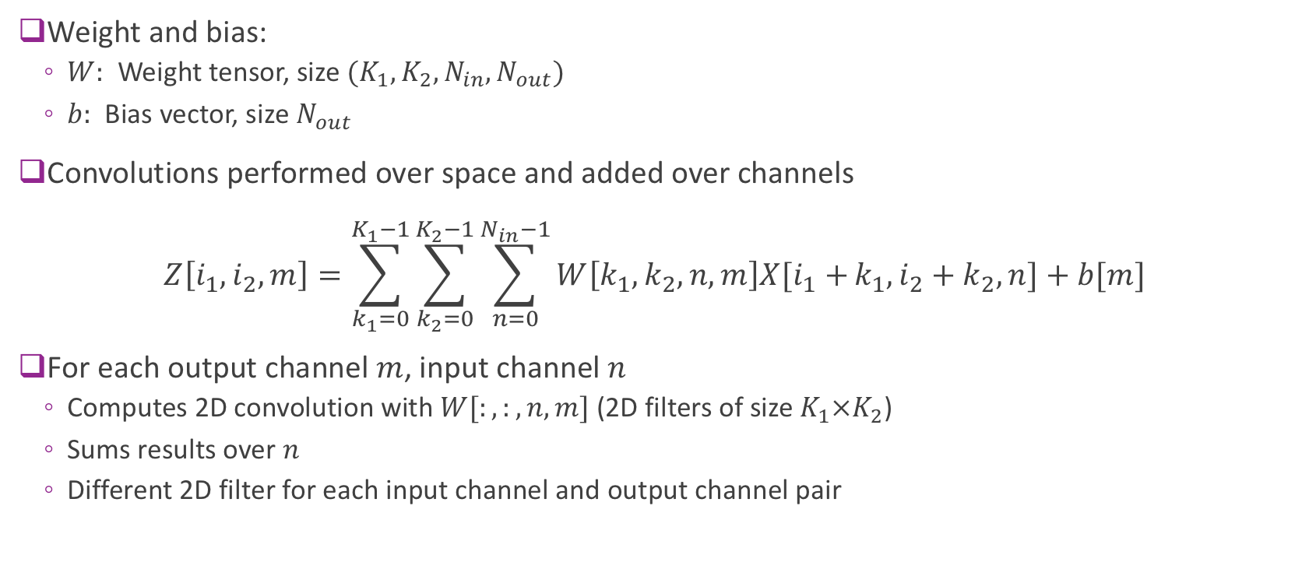
Convolutions with Multiple Channels
Weight and bias:
$W:$ Weight tensor, size $(K_{1},K_{2},N_{in},N_{out})$
$b:$ Bias vector, size $N_{out}$
Convolutions performed over space and added over channels $Z\left[i_{1},i_{2},m\right]=\sum_{k_{1}=0}^{K_{1}−1}{\sum_{k_{2}=0}^{K_{2}−1}{\sum_{n=0}^{N_{in}−1}{W\left[k_{1},k_{2},n,m\right]X[i_{1}+}}}k_{1},i_{2}+k_{2},n]+b[m]$
For each output channel $m$, input channel $n$
Computes 2D convolution with$W[:,:,n,m]$ (2D filters of size ${K_{1}×K}_{2}$)
Sums results over $n$
Different 2D filter for each input channel and output channel pair

Slide 42
Activation and Sub-Sampling
Convolution typically followed by activation and pooling
Activation, typically ReLU
Zeros out negative values
Sub-sampling
Downsample output after activation
Different methods (striding, sub-sampling or max-pooling)
Output combines local features from adjacent regions
Creates more complex features over wider areas
Details for sub-sampling not covered in this class
See web for more info

Slide 43
Convolution vs Fully Connected
Convolution exploits translational invariance
Same features is scanned over whole image
Greatly reduces number of parameters
Nin input channels of size M1xN1, Nout output channels with size M2xN2
Fully connected network: Nin*Nout*M1*N1*M2*N2+Nout*M2*N2
Convolutional network with K1xK2 filter: Nin*Nout*K1*K2+Nout
Example: Consider first layer in LeNet
32 x 32 image (1 channel) to 6 channels using 5 x 5 filters
Creates 6 x 28 x 28 outputs (keeping only the valid region)
Fully connected would require 32 x 32 x 6 x 28 x 28 + 6 x 28 x 28 = 4.9 million parameters!
Convolutional layer requires only 6 x 5 x 5 + 6 = 156 parameters
Reserve fully connected layers for last few layers (for non-image output such as classification).

Slide 44
Outline
Motivation: ImageNet Large-Scale Visual Recognition Challenge (ILSVR)
Deep Networks and Feature Hierarchies
2D convolutions
Convolutional neural networks
Creating and visualizing convolutional layers in Keras
Backpropagation training in CNNs
Exploring VGG16: A state-of-the-art deep network

Slide 45
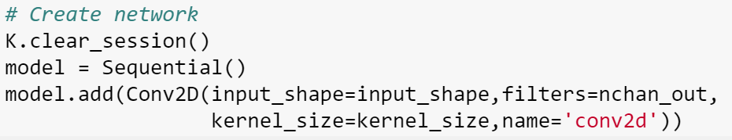
Creating Convolutional Layers in Keras
Done easily with Conv2d
Specify input_shape (if first layer), kernel size and number of output channels
To illustrate:
We create a network with a single convolutional layer
Set the weights and biases (normally these would be learned)
Run input through the layer (using the predict command)
Look at the output

Slide 46
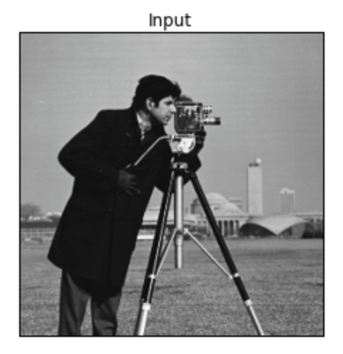

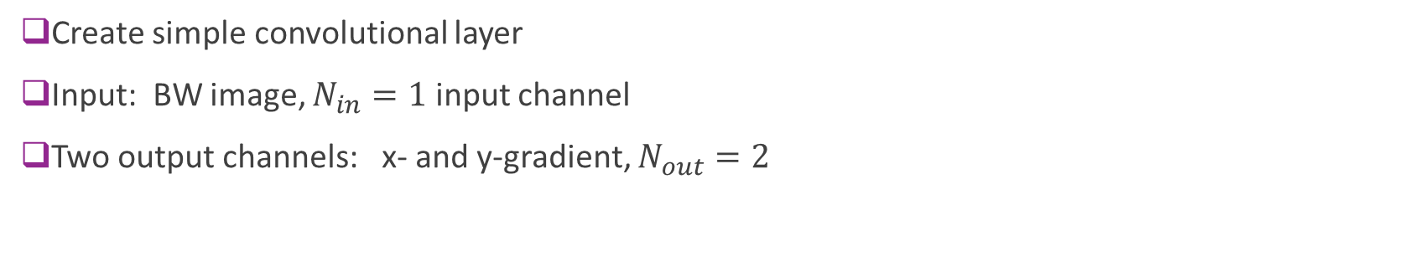
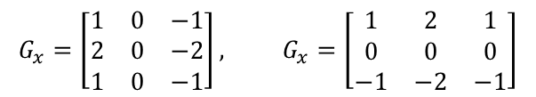
Example 1: Gradients of a BW image
Create simple convolutional layer
Input: BW image, $N_{in}=1$ input channel
Two output channels: x- and y-gradient, $N_{out}=2$
*
$$G_{x}=\left[\begin{matrix}1 & 0 & −1 \\ 2 & 0 & −2 \\ 1 & 0 & −1\end{matrix}\right], G_{x}=\left[\begin{matrix}1 & 2 & 1 \\ 0 & 0 & 0 \\ −1 & −2 & −1\end{matrix}\right]$$
Input.
One channel
Shape = (512,512,1)
Filters
Two gradient

Slide 47
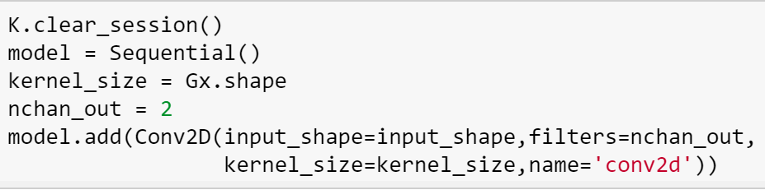

Create a Layer in Keras
Create a single layer model
Use the Conv2D layer
Specify
Kernel size
Number of output channels
Input shape
Why do we have 20 parameters?

Slide 48



Set the Weights
Read the weights and the shapes
Set the weights to the two filters
Normally, these would be trained
Run the input through the network

Slide 49

Perform Convolution in Keras
Create input x
Need to reshape
Use predict command to compute output
Generates two output channels y
y[:,:,0]
y[:,:,1]
Input x
*
Filters
Two gradients

Slide 50



Example 2: Color Input
Input: Single color input
$N_{in}=3$ input channels
Input size per sample = 368 x 487 x 3
Output: Filter with four different color filters
Each kernel is 9 x 9
$N_{out}=4$ output channels
*

Slide 51

Create the Layer in Keras
Model with single layer
Input shape = (368, 488,3)
Output shape = (360,479,4)
What the number of parameters is 976?

Slide 52


Set the Weights
Consider weight of the form: $W\left[i,j,k,ℓ\right]=G\left[i,j\right]C[ℓ,k]$
$G\left[i,j\right]$= filter over space
Use Gaussian blur
$C[ℓ,k]$ = filter over channel
Weighting of color $k$ in output channel $ℓ$
Each filter:
Average over space and selects color
Again, normally we would train the weights

Slide 53


Perform Convolution
Input, x
(3 channels)
Filters, W (9,9,3,4)
*
Output y 4 channels
y[:,:,0]
y[:,:,1]
y[:,:,2]
y[:,:,3]

Slide 54
Alex Net
Alex Krizhevsky, Ilya Sutskever, Geoffrey E. Hinton, University of Toronto, 2012
Key idea: Build a very deep neural network
60 million parameters, 650000 neurons
5 conv layers + 3 FC layers
Final is 1000-way softmax
Use RELU as regularizer
Use dropout for training
Top winner in imagenet competition in 2012
Krizhevsky, Alex, Ilya Sutskever, and Geoffrey E. Hinton. "Imagenet classification with deep convolutional neural networks." Advances in neural information processing systems. 2012.

Slide 55
First layer filter in AlexNet
AlexNet first layer
96 filters
Size 11 x 11 x 3
Applied to image of 224 x 224 x 3
What do these learned features look like?
Selective to basic low-level features
Curves, edges, color transitions, …

Slide 56
Outline
Motivation: ImageNet Large-Scale Visual Recognition Challenge (ILSVR)
Deep Networks and Feature Hierarchies
2D convolutions
Convolutional neural networks
Creating and visualizing convolutional layers in Keras
Backpropagation training in CNNs
Exploring VGG16: A state-of-the-art deep network

Slide 57





Indexing Multi-Layer Networks
Similar to single layer NNs
But must keep track of layers
Consider batch of image inputs:
$X[i,j,k,n]$, (sample,row,col,channel)
Input tensor at layer $ℓ$:
$U^{ℓ}[i,j,k,n]$ for convolutional layer
$U^{ℓ}[i,n]$ for fully connected layer
Output tensor from linear transform:
$Z^{ℓ}\left[i,j,k,n\right]$ or $Z^{ℓ}\left[i,n\right]$
Output tensor after activation / pooling:
$U^{ℓ+1}\left[i,j,k,n\right]$ or $U^{ℓ+1}\left[i,n\right]$
Convolution or fully-connected
Activation, pooling
$$U^{ℓ}$$
$$Z^{ℓ}$$
$$U^{ℓ+1}$$
$$W^{ℓ},b^{ℓ}$$
Weight-bias

Slide 58











Back-Propagation in Convolutional Layers
Input $$X$$
Convolution $$Z^{ℓ}=W^{ℓ}∗U^{ℓ}+b^{ℓ}$$
Loss function $$J\left(θ\right)$$
$$U^{ℓ}$$
$$⋯$$
$$⋯$$
$$\frac{∂J}{∂U^{ℓ }}$$
$$\frac{∂J}{∂Z^{ℓ }}$$
Convolutional layer in forward path
$$Z^{ℓ}=W^{ℓ}∗U^{ℓ}+b^{ℓ}$$
During back-propagation:
Obtain gradient tensor from upstream layers $\frac{∂J}{∂Z^{ℓ }}$
Need to compute downstream gradients: $\frac{∂J}{∂W^{ℓ }}, \frac{∂J}{∂b^{ℓ}}, \frac{∂J}{∂U^{ℓ}}$
$$\frac{∂J}{∂W^{ℓ }}, \frac{∂J}{∂b^{ℓ}}$$
$$W^{ℓ},b^{ℓ}$$

Slide 59

Gradient Details
Write convolution as: $Z\left[i_{1},i_{2},m\right]=\sum_{k_{1}=0}^{K_{1}−1}{\sum_{k_{2}=0}^{K_{2}−1}{\sum_{n=0}^{N_{in}−1}{W\left[k_{1},k_{2},n,m\right]U[i_{1}+}}}k_{1},i_{2}+k_{2},n]+b\left[m\right]$
Drop layer index $ℓ$ and sample index $i_{}$
In backpropagation, we receive gradient tensor: $\frac{∂J}{∂Z\left[i_{1},i_{2},m\right]}$
First compute gradient wrt weights: $\frac{∂J}{∂W[k_{1},k_{2},n,m]}$

Slide 60

Gradient With Respect to Weights
Gradient wrt weights:
$$\frac{∂Z\left[i_{1},i_{2},m\right]}{∂W[k_{1},k_{2},n,m]}=U\left[i_{1}+k_{1},i_{2}+k_{2},n\right]$$
By chain rule: $\frac{∂J}{∂W[k_{1},k_{2},n,m]}=\sum_{i_{1}=1}^{N_{1}}{\sum_{i_{2}=1}^{N_{2}}{\frac{∂Z\left[i_{1},i_{2},m\right]}{∂W[k_{1},k_{2},n,m]}}}\frac{∂J}{∂Z\left[i_{1},i_{2},m\right]}$ $=\sum_{i_{1}=1}^{N_{1}}{\sum_{i_{2}=1}^{N_{2}}{U[i_{1}+k_{1},i_{2}+k_{2},n]}}\frac{∂J}{∂Z\left[i_{1},i_{2},m\right]}$
Gradient wrt weights can be computed via convolution
Convolve input $U$ with gradient tensor $\frac{∂J}{∂Z\left[i_{1},i_{2},m\right]}$
Similar computations for gradients with respect to $\frac{∂J}{∂b}, \frac{∂J}{∂U}$
See homework

Slide 61


GPUs
State-of-the-art networks involve millions of parameters
Require enormous datasets
Conventional processors cannot train in reasonable time
Use Graphics Processor Units
Originally for graphics acceleration
Now essential for deep learning
Cannot use the GPU on your laptop
But, can:
Rent GPU instances in cloud (~$0.80 / hour)
Purchase GPU workstation (~$2000)
Speed up on 2012 ImageNet winner using Nvidia Tesla K40
From http://www.nvidia.com/content/events/geoInt2015/LBrown_DL.pdf
Much faster results available today

Slide 62
Outline
Motivation: ImageNet Large-Scale Visual Recognition Challenge (ILSVR)
Deep Networks and Feature Hierarchies
2D convolutions
Convolutional neural networks
Creating and visualizing convolutional layers in Keras
Backpropagation training in CNNs
Exploring VGG16: A state-of-the-art deep network

Slide 63

Pre-Trained Networks
State-of-the-art networks take enormous resources to train
Millions of parameters
Often days of training, clusters of GPUs
Extremely expensive
Pre-trained networks in Keras
Load network architecture and weights
Models available for many state-of-the-art networks
Can be used for:
Making predictions
Building new, powerful networks (see lab)
https://keras.io/applications/

Slide 64

VGG16
From the Visual Geometry Group
Oxford, UK
Won ImageNet ILSVRC-2014
Remains a very good network
Lower lower layers are often used as feature extraction layers for other tasks
Will load this network today
http://www.robots.ox.ac.uk/~vgg/research/very_deep/
K. Simonyan, A. Zisserman
Very Deep Convolutional Networks for Large-Scale Image Recognition
arXiv technical report, 2014

Slide 65
https://blog.heuritech.com/2016/02/29/a-brief-report-of-the-heuritech-deep-learning-meetup-5/

Slide 66


Loading the Pre-Trained Network
Load the packages
Create the model
Downloads the h5 file
First time, may be a while
500 MB file

Slide 67


Display the Network
Very deep: 16 layers (Do not count pooling layers)
130 million parameters!

Slide 68

Get Some Test Images
Get images from the web of some category (e.g. elephants)
Many possible sources.
Example: Flickr API (see Demo in github)
Re-size / pad images so that they match expected input of VGG16
Input shape (224, 224, 3)

Slide 69


Make Predictions
Pre-process
Predict
Runs input through network
Decode predictions
Creates data structure for outputs

Slide 70

ImageNet Classification can be Hard
Some categories differences are subtle

Slide 71



Intermediate Layers
Often need outputs of hidden layers
Provides “latent” representation of image
Can be useful for other tasks
See lab
In Keras, create new model
Specify output layers
Predict with new model to extract hidden outputs
Hidden layers see high level of sparsity
Many coefficients are zero

Slide 72
Output of first few convolution layers
Output of first convolution layers (first 4 channels) for a given image
First, third, and fourth channels looks like gradient images in different directions
In general, first few layers extract low level features!

Slide 73
Output of higher layers
Output of last layer before the flatten layer (first 4 channels)
These carry “high level semantic information” about object category
See demo for outputs of other layers

Slide 74


Try It Yourself!
= ?

Slide 75
Regularization: Batch normalization
In addition to normalize the input data, also normalize the input to each intermediate layer within each batch
Then rescale the data using two parameters
Can use a higher learning rate and hence converge faster
Reduces overfitting: more invariant to intensity shift
https://www.youtube.com/watch?v=nUUqwaxLnWs
https://towardsdatascience.com/batch-normalization-in-neural-networks-1ac91516821c
Sergey Ioffe, Christian Szegedy: Batch Normalization: Accelerating Deep Network Training by Reducing Internal Covariate Shift.
https://arxiv.org/pdf/1502.03167v3.pdf

Slide 76
Regularization: Dropout
Drop some percentage of nodes in each layer both in forward and backward pass in each training epoch
Implemented by setting a certain input elements to this layer to zero
Dropout forces a neural network to learn more robust features that are useful in conjunction with many different random subsets of the other neurons.
Reduces overfitting
Need more epochs to converge but each epoch takes less time
Srivastava, Nitish, et al. ”Dropout: a simple way to prevent neural networks from overfitting”, JMLR 2014

Slide 77
Data Augmentation
When the training data are limited, can generate additional samples based on the anticipated diversity in the input data
Image augmentation: by shifting, scaling, rotating the original training images
from keras.preprocessing.image import ImageDataGenerator
datagen = ImageDataGenerator(
featurewise_center=False, # set input mean to 0 over the dataset
samplewise_center=False, # set each sample mean to 0
featurewise_std_normalization=False, # divide inputs by std of the dataset
samplewise_std_normalization=False, # divide each input by its std
zca_whitening=False, # apply ZCA whitening
rotation_range=0, # randomly rotate images in the range (degrees, 0 to 180)
width_shift_range=0.1, # randomly shift images horizontally (fraction of total width)
height_shift_range=0.1, # randomly shift images vertically (fraction of total height)
horizontal_flip=True, # randomly flip images
vertical_flip=False) # randomly flip images

Slide 78
Demo: Training a small image classifier
Train an image classifier using the CIFAR10 data (32x32 color images, 10 classes)
Two conv layer each followed by max pooling, two dense layer
Compare different training procedures:
Basic: Without batch normalization nor dropout: Stops improving after one epoch
+BN: With batch normalization : significant improvement
+Dropout: With slightly better performance on validation set
+Data Augmentation:
Performance limited by the small training set and limited number of epochs used.
Go through demo

Slide 79
Autoencoder
CNN is not limited for classification!
When all the layers are convolution, the output can have the same shape as the input (speech->speech, image->image)
Autoencoder= Encoder+Decoder
Encoder: image-> features;
Decoder: features -> image

Slide 80
Demo: Autoencoder for image denoising
Using a subset of training samples in the cifar10 dataset
2 encoding layers producing 32 (or 16) channels, 3 decoding layers

Slide 81
Other Applications of autoencoders
Image processing applications:
Image compression
Image segmentation
Saliency detection
Other applications
Unsupervised feature extraction
Speech denoising …
Language translation
…
Autoencoder loss depends on the underlying application
Using adversarial loss can help to make the output look more like the target output (beyond this class)
https://github.com/arahusky/Tensorflow-Segmentation

Slide 82
Lab: Transfer Learning with a Pre-Trained Deep Neural Network (VGG)
For image classification or other applications, training from scratch takes tremendous resources
Instead, can refine the VGG or other well trained networks
Can use VGG convolutional layers, and retrain only the fully connected layers (possibly some later convolutional layers) for different problems.
Or can use VGG conv layers as the “initial model” and further refine.
Lab: load VGG model, and fix all conv. Layers, retrain additional fully connected layers for binary classification, try and compare different training tricks
Using Flickr API for downloading images for a given keyword

Slide 83
What you should have learnt?
Convolution as local feature matching
Convolutional neural networks for feature extraction
Backpropagation training in CNNs
Creating and visualizing convolutional layers in Keras
Exploring VGG16: A state-of-the-art deep network
Regularization: batch normalization and dropout
Data augmentation
Autoencoder for non-classification task
Transfer learning

